Slide 1

Science Groups
House Point Competition

Slide 2
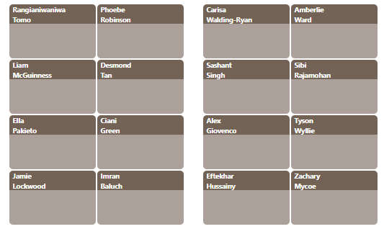

Slide 3
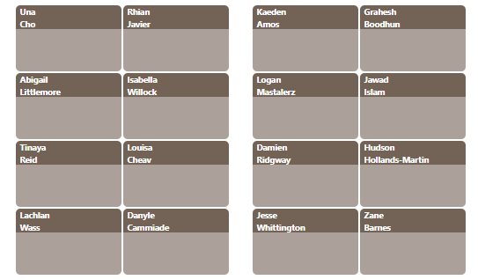

Slide 4

There is four groups:
Chemists

Slide 5
There is four groups:
Astronomers

Slide 6
There is four groups:
Biologists

Slide 7
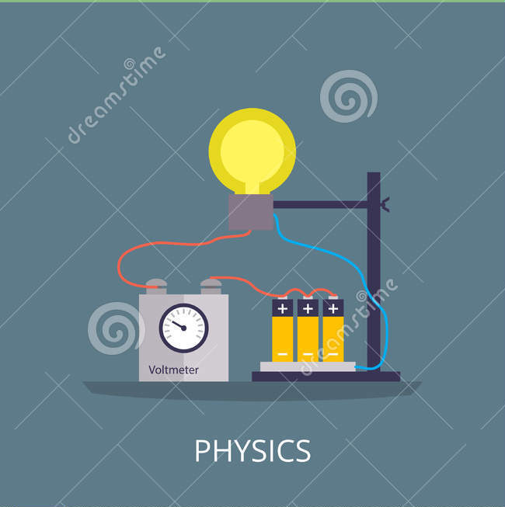
There is four groups:
Physicists

